Slide 1
ArcadeMania

Slide 2
PURPOSE
Arcade Mania, a website to play various games.
Player need or need not have to signup he can be a guest too, cool right?.
Player can mark his favorite games and re-playing gets easier.
You want to compete? well there's leaderboard too.
Enjoy gaming!!

Slide 3
THIS IS OUR TEAM.
Venkata Naga Sai Teja Marlapati
Harika Ramidi
Mayur Prabhakar Sangale
Divya Dipak Kharche

Slide 4









TECH STACK

Slide 5
Games
2048
Bet Card
Car Crash
Connect4
Hangman
Memory Game
Mine Sweeper
Rock Paper Scissors
Snake Game
Tic Tac Toe
Typing Speed

Slide 6
Features & Modules
3 | Favorites & Recently Played
1 | Authentication
2 | Leaderboard
5 | User Profile
6 | Dashboard
Sign Up & Sign In
Google Sign in
Top Scores for each game
Set/Unset Game Favorite
Last Played Game by user
4 | User Preferences
Support Theme Personalization
Customize User Profile
Interactive Game Dashboard
User Favorites Dashboard

Slide 7
Contributions
Harika
Teja
Mayur
Divya
Authentication
My Profile
Games: Car Crash, Snake Game, Connect4, Rock-Paper-Scissors
Game Dashboard
Favorites Dashboard & Sidebar
Recently Played
Games: 2048, Minesweeper
Leaderboard
Games: TicTacToe, Hangman, TypingSpeed
Leaderboard
Games: Bet Card, Memory Game

Slide 8
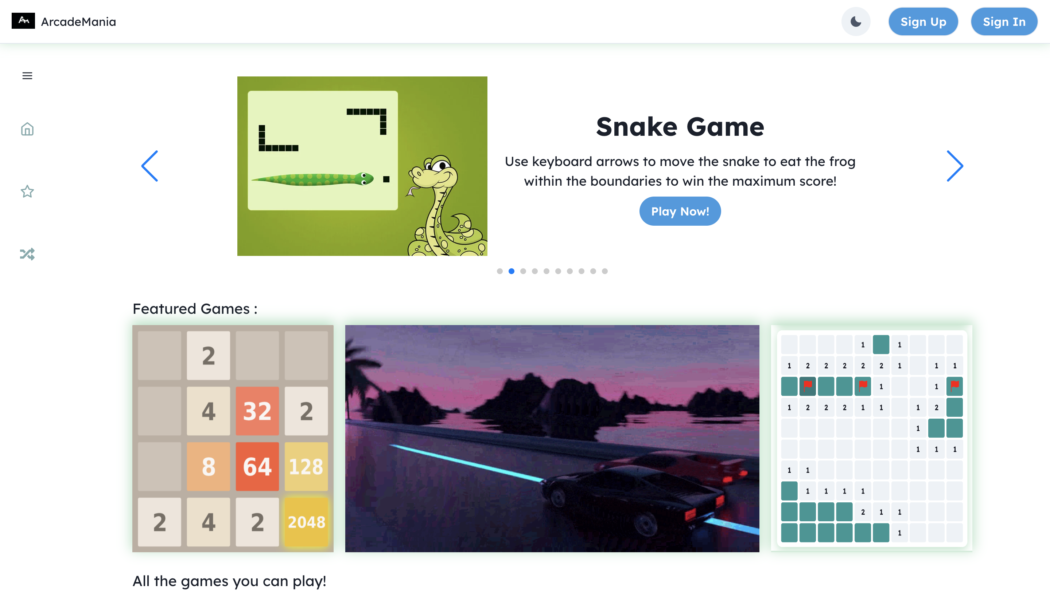
Desktop View

Slide 9
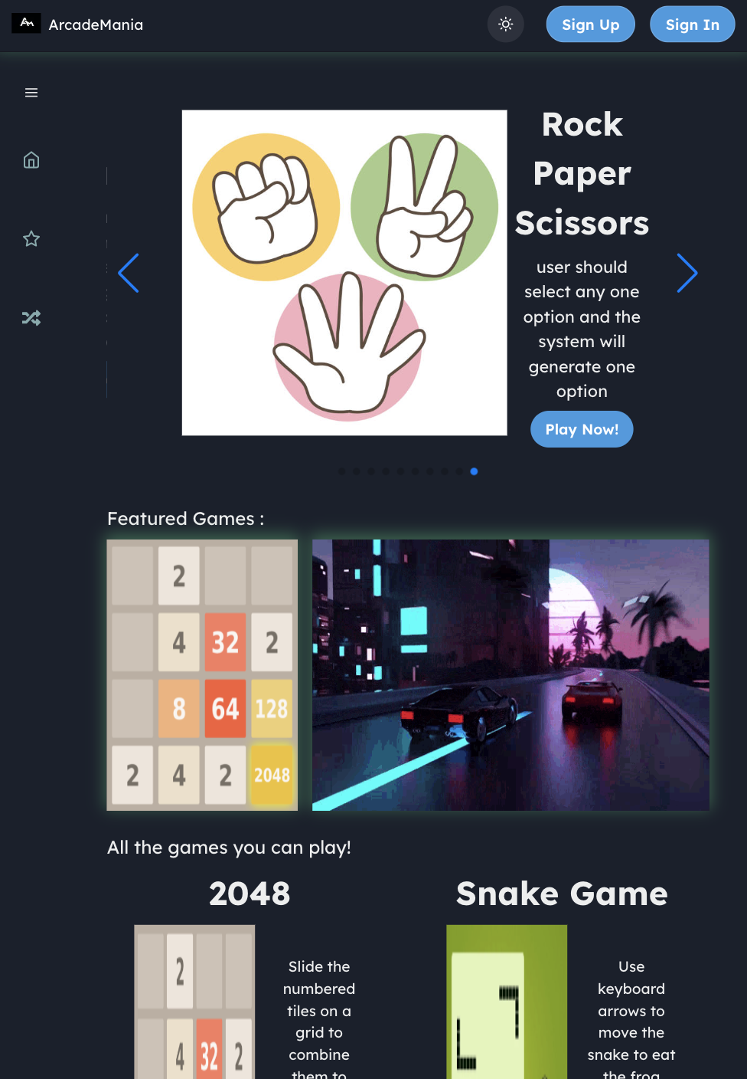
Tab View

Slide 10

References
NextJS (https://nextjs.org/docs/getting-started)
Chakra UI (https://chakra-ui.com/)
Javascript Game Ideas (https://www.webtips.dev/javascript-game-ideas)
Sass Docs (https://sass-lang.com/documentation)
PassportJS Docs (https://www.passportjs.org/docs)
React & Redux (https://reactjs.org/docs)

Slide 11
THANK YOU!

